Slide 1

AWS Project: Create and Manage a nonrelational database
By: Mohamed Sultan

Slide 2
Technologies used:
Cloud 9
SDK for Python (boto3)
DynamoDB

Slide 3
Introduction
For this project, I created a DynamoDB table and used that table to store and retrieve data. I used Python and Boto 3 which is the AWS SDK for Python, for interacting with the DynamoDB APIs. In order to accommodate the evolving needs of the online bookstore application that we use as a guide for this project.

Slide 4

Dynamodb
What is DynamoDB?
What it offers:
Low-latency performance as it scales automatically
Accessible over an HTTP API or an HTTPS endpoint
Allows for flexible schema design that can evolve
DynamoDB is a hosted NoSQL database offered by Amazon Web Services (AWS)

Slide 5
Important Terminology
Attribute: A single data element on an item. It is comparable to a column in a relational database. However, unlike columns in a relational database, attributes do not need to be specified at table creation, other than the primary key. Attributes can be simple types such as strings, integers, or Boolean, or they can be complex types such as lists or maps.
Primary key: A primary key is a unique identifier for a single item in a DynamoDB table. The primary key name and type must be specified on table creation, and a primary key of the specified type must be included with each item written to a table. A simple primary key consists of a single attribute, and a composite primary key consists of two attributes: a partition key and a sort key.
Table: A collection of DynamoDB data records.
Item: A single data record in a DynamoDB table. It is comparable to a row in a relational database.

Slide 6
Cloud 9
What is Cloud 9?
What it offers:
Includes a code editor, debugger, and terminal
Supports popular programming languages
Seamless experience for developing serverless applications
AWS Cloud9 is a cloud-based integrated development environment (IDE) that lets you write, run, and debug your code with just a browser.

Slide 7
Application Requirements
The application must show users the books that are available for sale as well as some basic information about the book, such as its author
The application needs to retrieve a specific book by its title and author so that a user can drill in for more detail when looking at a book
The application should store the different formats you have in stock for a book with a mapping to the item number in your inventory system, and allow these formats to be updated
The application should allow users to browse all books in a particular category, such as history or biography, to allow for discoverability of interesting books

Slide 8
Project Objectives
Download and unpack the python scripts that we use to interact with the DynamoDB API, and install Python Boto3
Create a DynamoDB Table
Add a secondary index to our table
Load items to our DynamoDB table
Retieve a single item AND multiple items from our DynamoDB table
Query against the new secondary index
Update items in our table

Slide 9
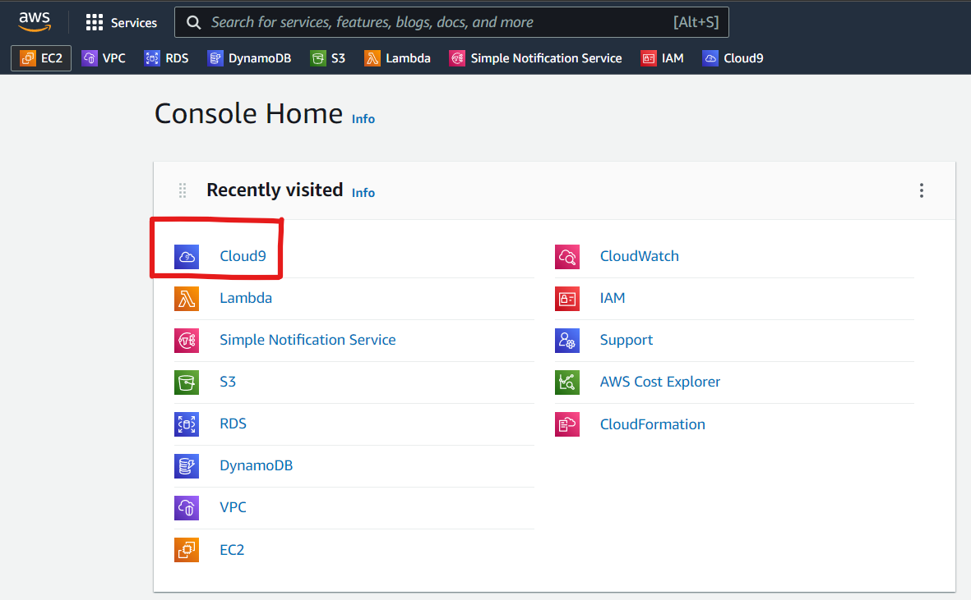
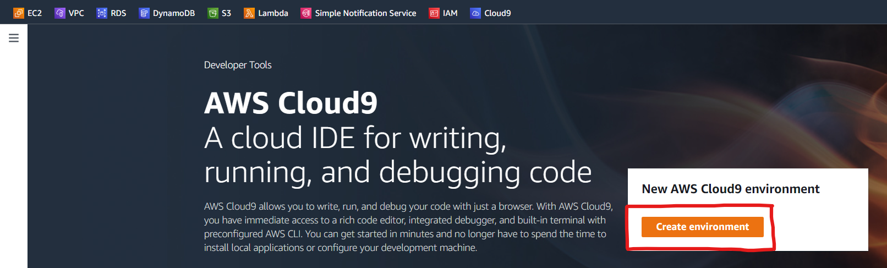
Project Implementation
Cloud9 Set up
First step is to set up my Cloud 9 environment: (Steps below)

Slide 10
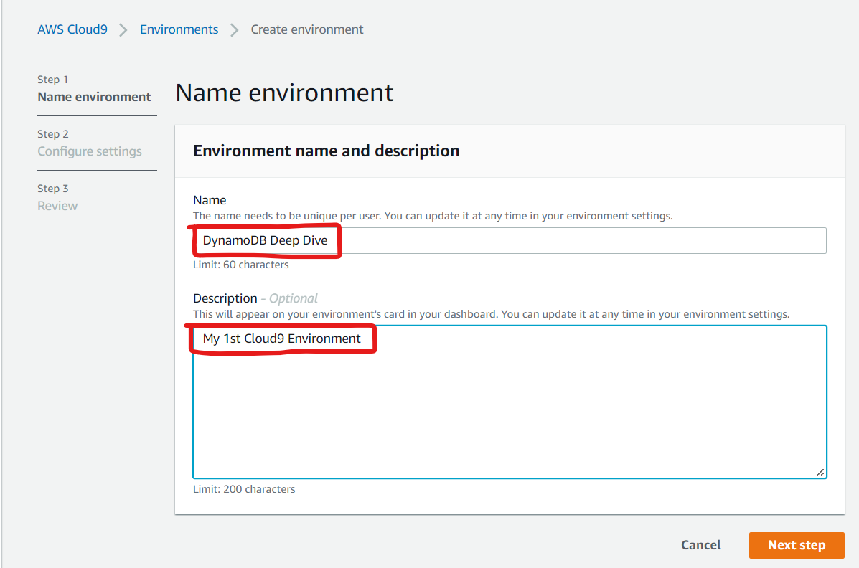
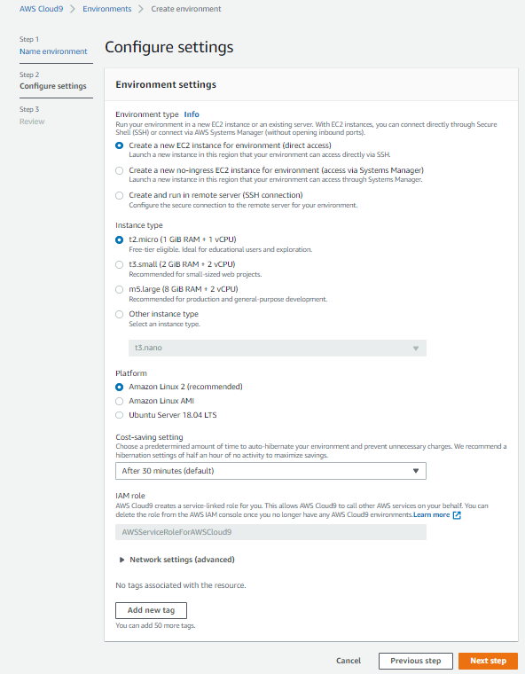
Project Implementation
Cloud9 Set up

Slide 11
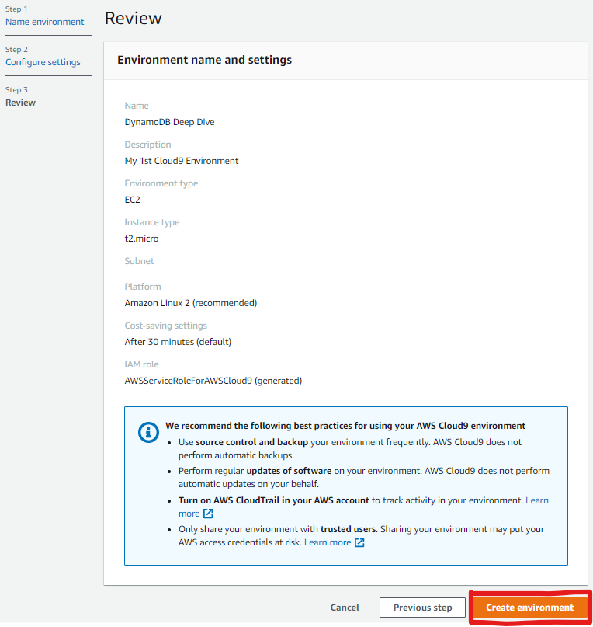
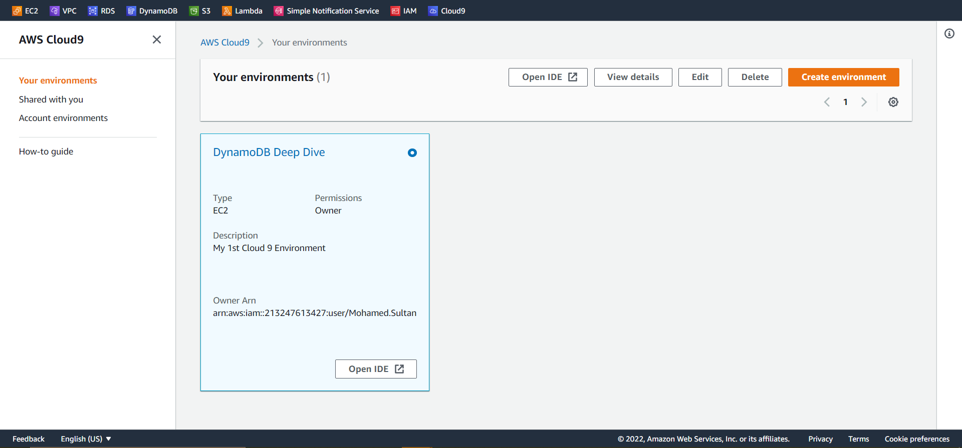
Project Implementation
Cloud9 Set up

Slide 12
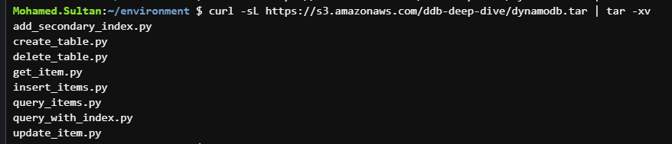
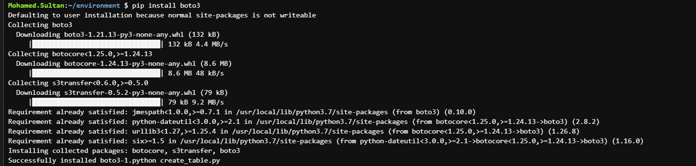
Project Implementation
Cloud9 IDE
Second step is to download and unpack the python scripts that we use to interact with the DynamoDB API, and install Boto3:

Slide 13
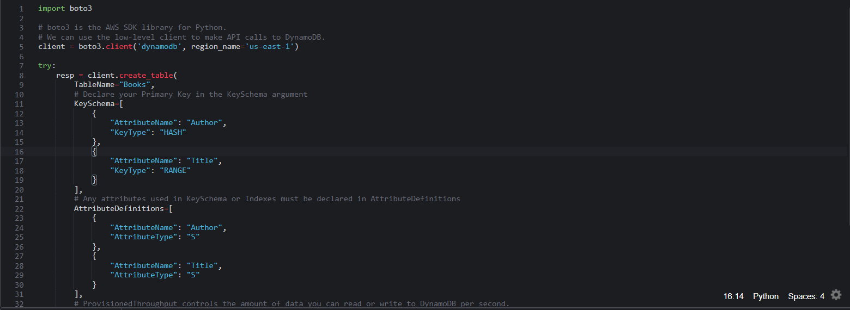
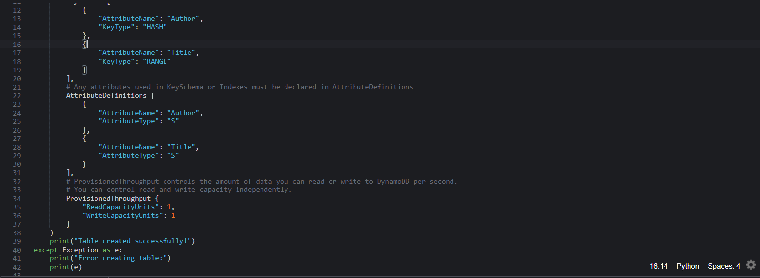
Project Implementation
Create DynamoDB
Third step is to Create a DynamoDB table using the Create_Table API to Insert and Retrieve Items from it:
The above command runs the below script that creates our DynamoDB table for us.

Slide 14
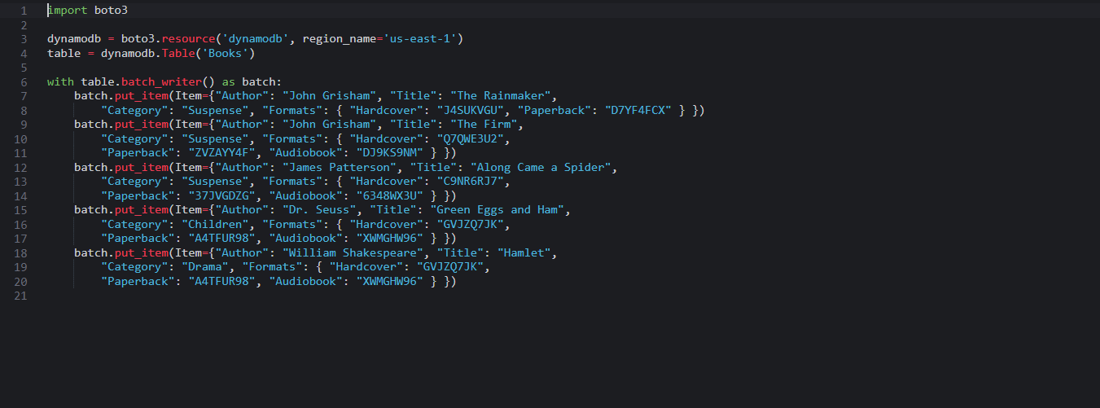
Project Implementation
Load Items
In this step: I loaded 5 books into the table we created:
The above command runs the below script which uses the BatchWriteItem API to load five books into the table.

Slide 15
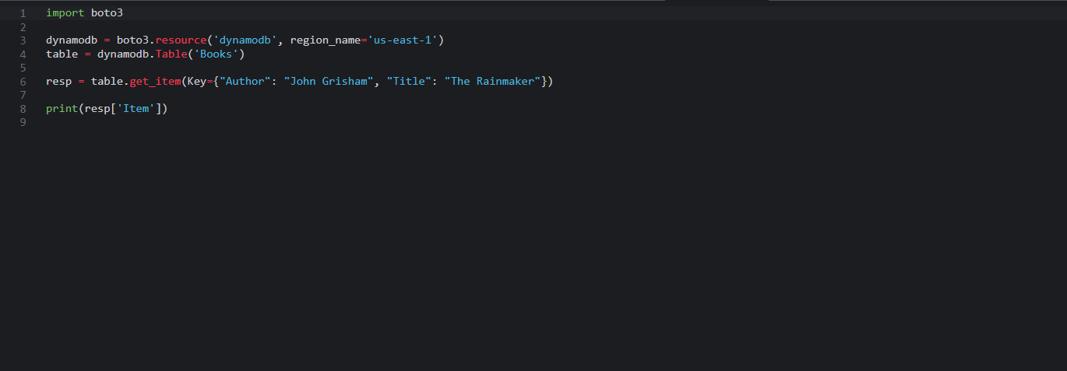
Project Implementation
Retrieve single Item
In this step: I retrieved a book by using the GetItem API request and specifying the primary key of the item I want from the table we created:
The above command runs the below script to retrieve a single item (book).

Slide 16
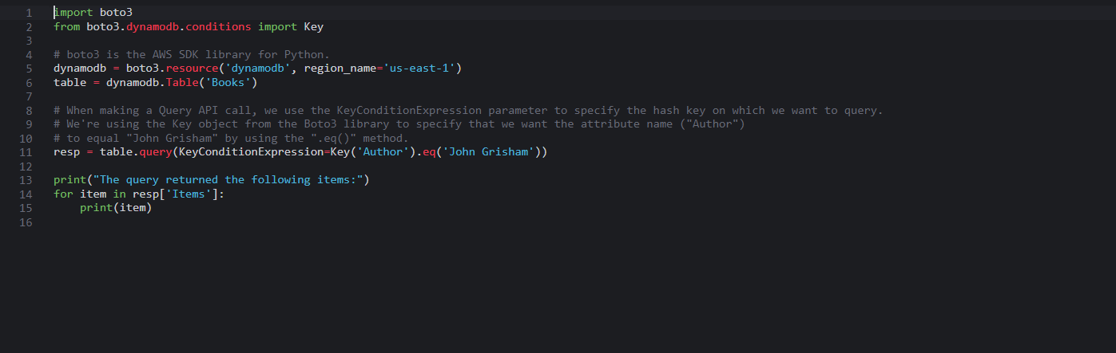
Project Implementation
Retrieve multiple Items
In this step: I retrieved all items (books) with the same hash key (Author attribute) by using the Query API call from the table we created:
The above command runs the below script to retrieve all books written by John Grisham.

Slide 17
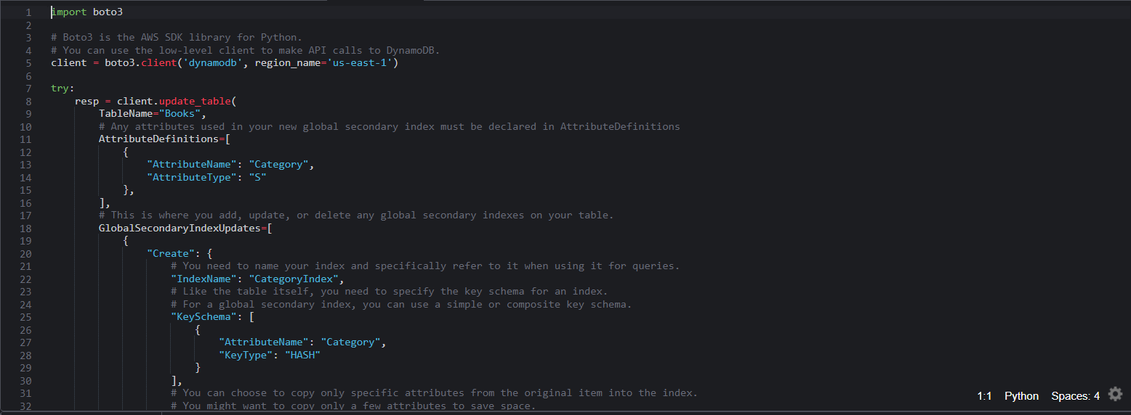
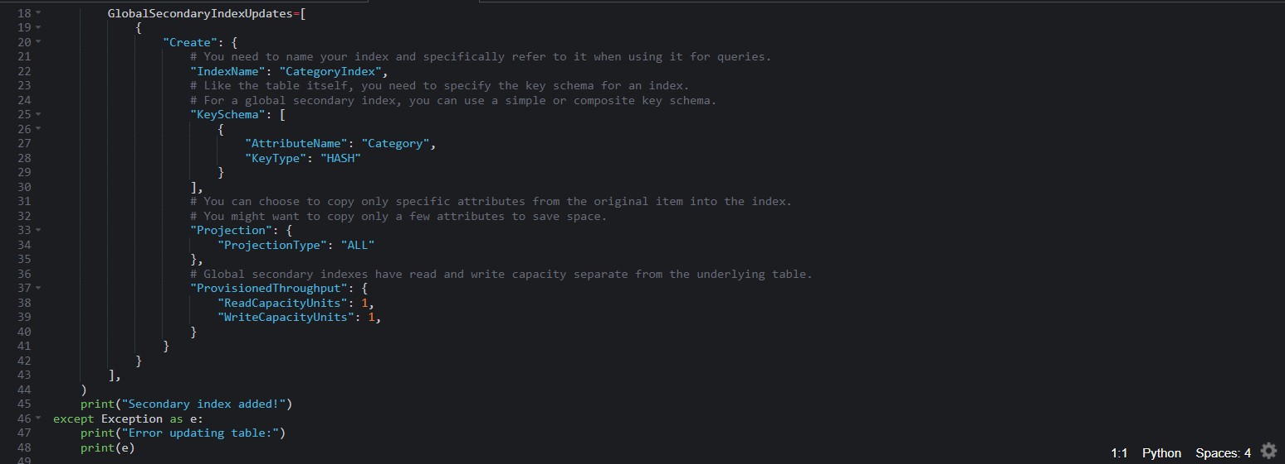
Project Implementation
Adding global secondary index
In this step: I added a global secondary index to my Category attribute that will allow me to retrieve all books in a particular category:
The above command runs the below script to add a global secondary index to our existing table to account for additional data access patterns.

Slide 18
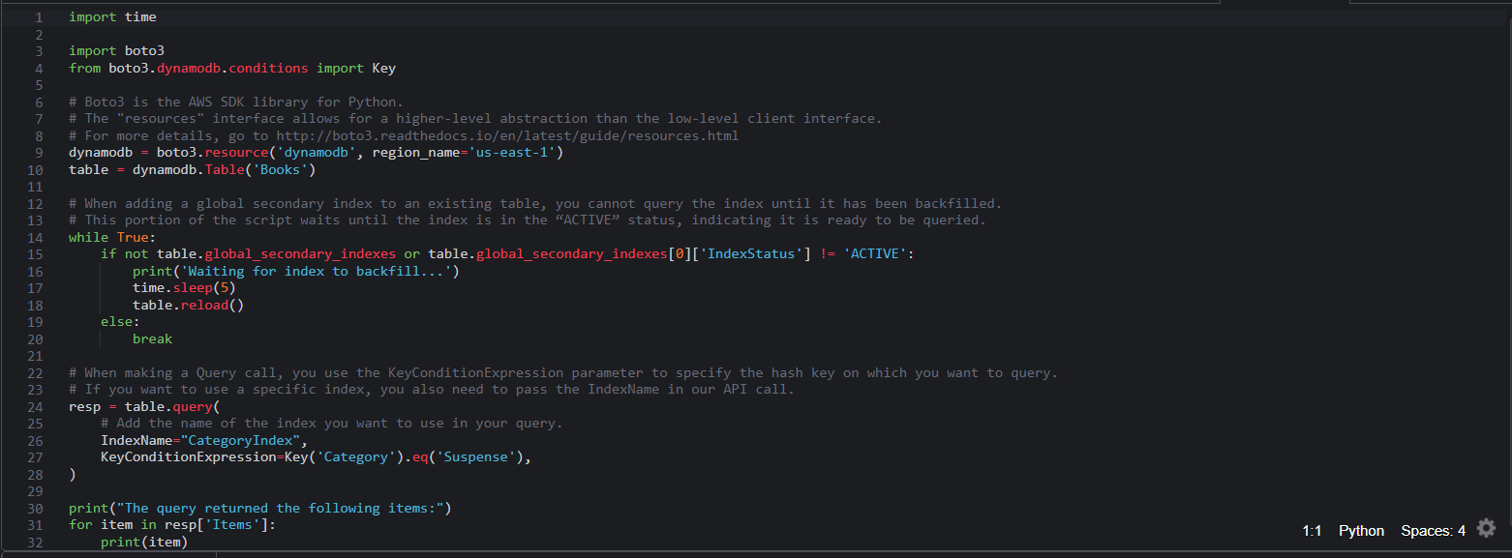
Project Implementation
Querying a secondary index
In this step: Now that I have the CategoryIndex, I can use it to retrieve all books with a particular category using the query_with_index.py script:
The above command runs the below script to query against the new index that I just created to account for additional data access patterns for our table.

Slide 19
Project Implementation
Querying a secondary index
Step continued: Now that I have the CategoryIndex, I can use it to retrieve all books with a particular category using the query_with_index.py script:
The above command runs the query_with_index.py script and returns three books by two different authors, but are in the same Category as shown below.
The run time to backfill items varies based on the size of the table.

Slide 20
Project Implementation
Updating Items
In this step: I used the UpdateItem API to update attributes of an existing item in our database:
4 elements to focus on while updating an element in my application code:
The Key that identifies the item you want to update
Expression attribute names
Expression attribute values
The update expression, which uses the expression attribute names and expression attribute values to declare the updates you want
In order to run the update_item.py script, I first had to add these 3 lines to it.

Slide 21
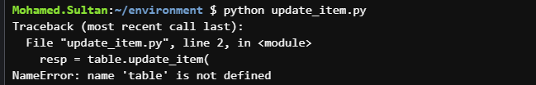
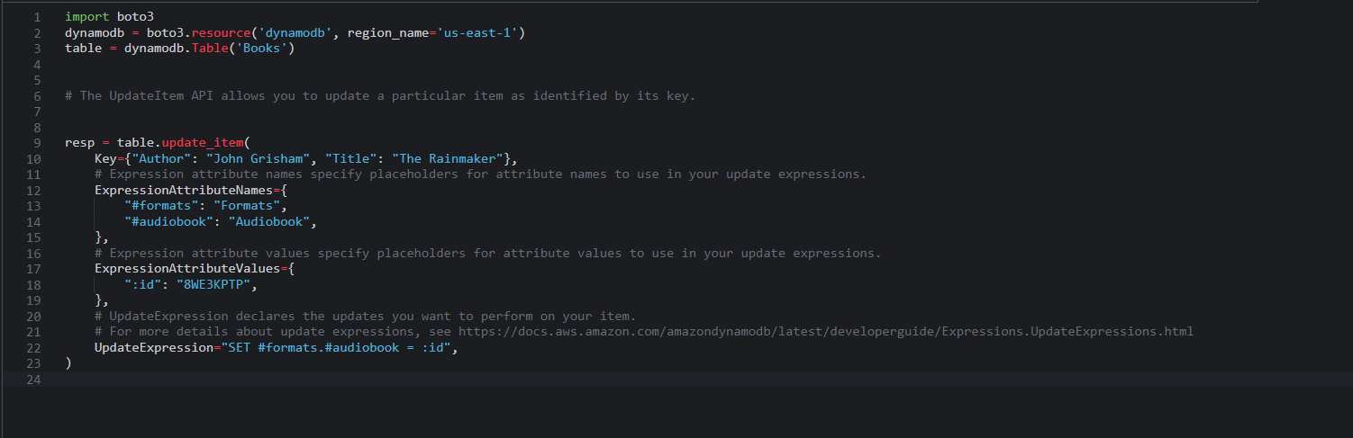
Project Implementation
Updating Items
Step continued: Now that I added these 3 lines of code to the update_item.py script, I can run it using the command below:
The above command runs the update_item.py script (shown below) .

Slide 22
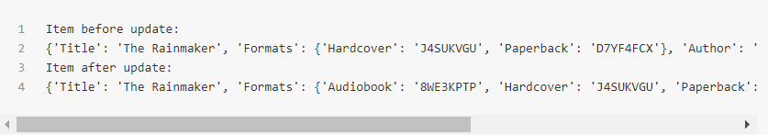
Project Implementation
Updating Items
Step continued: The command below didn't work with me as we can see.
However, the result of running the update_item.py script should have been as follows: Where we can see that The Rainmaker book title has a new Audiobook format after the update has been applied.

Slide 23

The END
THANK YOU!

